Slide 1

British Values
Understanding Our Core Values

Slide 2

Introduction
Welcome to St Marys. In this PowerPoint we will tell you about the important values that help us live together happily and respectfully and how we use these within our school.

Slide 3
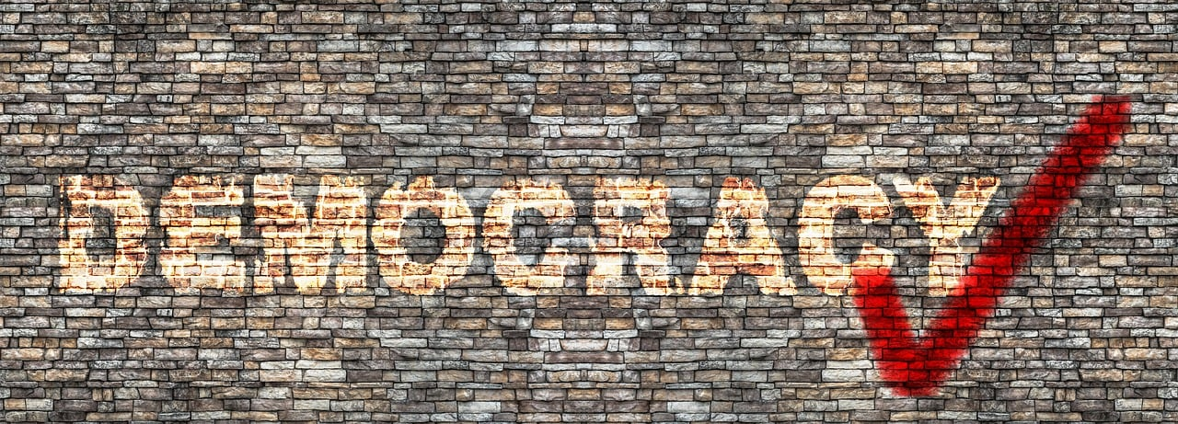
Democracy
Democracy means everyone has a say. We vote to make decisions together.
I know I have a voice, and my opinions will be heard
I can listen carefully to others
I know how to discuss an issue in a calm way and can show respect for others even if I disagree
My vote counts

Slide 4
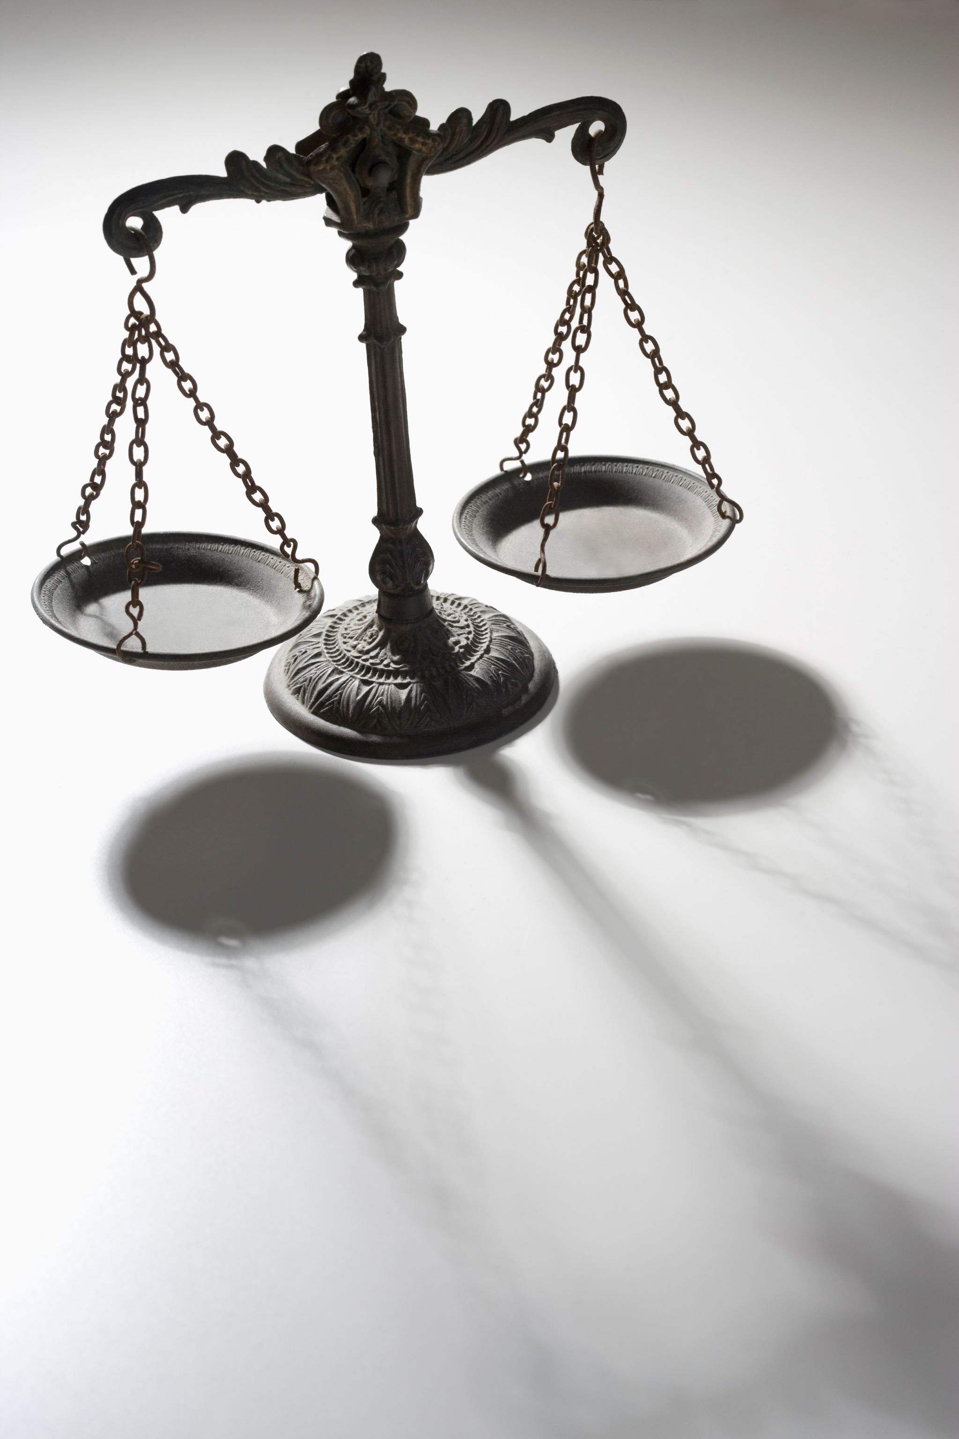
Rule of Law
The rule of law means we all follow the same rules. Rules keep us safe and happy.
I value and understand the importance of rules and understand why there is a consequence if I do not
I follow school rules and understand why there is a consequence if not
I understand that everybody is responsible for rules and laws
I know rules are there to protect me

Slide 5
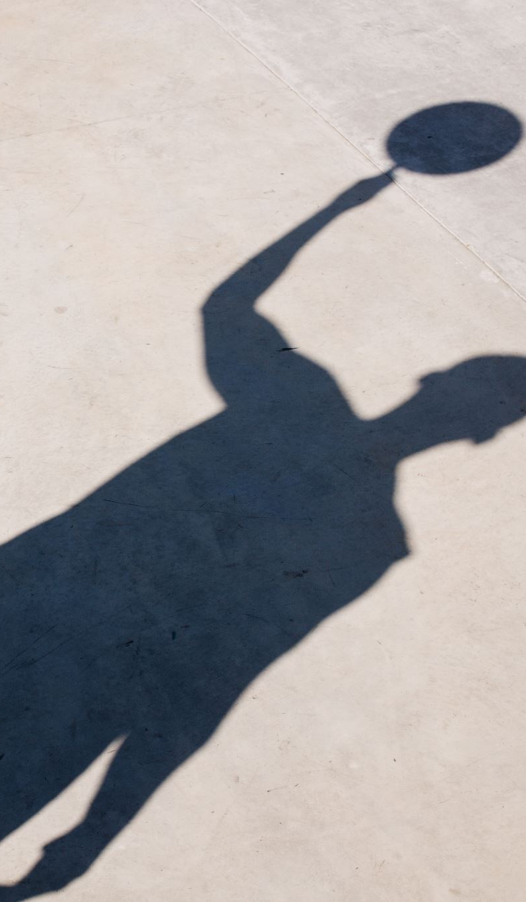
Individual Liberty
Individual liberty means we are free to make our own choices. We can choose our friends, hobbies, and more.
I make the right choices
I take responsibility for my actions
I understand the consequences of my actions
I manage risks
I know how to exercise my rights and freedoms in an appropriate way

Slide 6
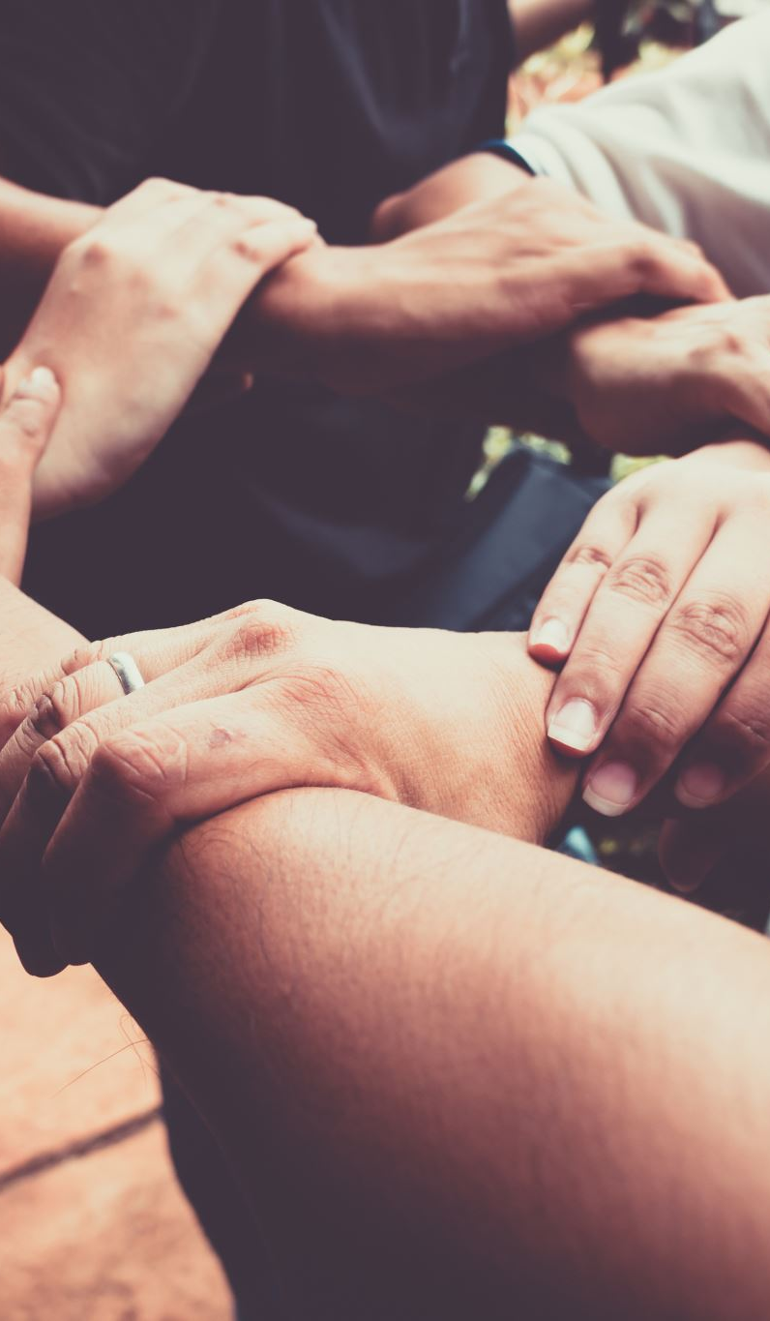
Mutual Respect and Tolerance
Mutual respect means we treat others the way we want to be treated. We are kind and polite.
I know my behaviour, actions and words can affect others
I understand and respect that not everyone is the same as me and everyone needs to be treated as an individual
I know that life is not the same for everyone
I understand that people’s faiths and beliefs are different, and I respect that
Tolerance means we accept and celebrate our differences. We learn about and respect different cultures and religions.

