Slide 1
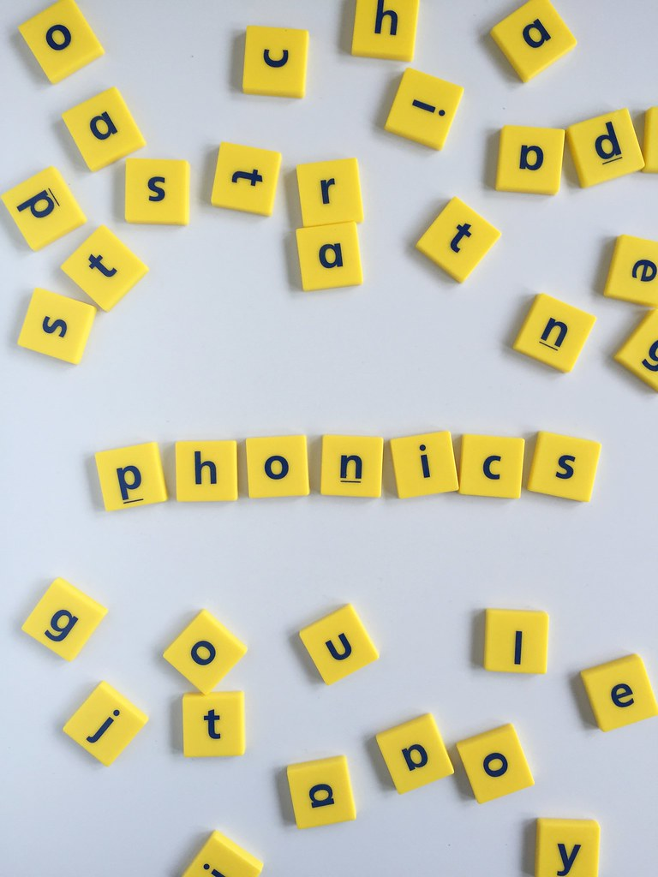
9.04.24

Slide 2
what is phonics?
A method of teaching reading – the
relationship between sounds and letters.

Slide 3
We use the sounds not the letter names, and we try to be very precise when sounding out the letters.
m
p
l
t

Slide 4
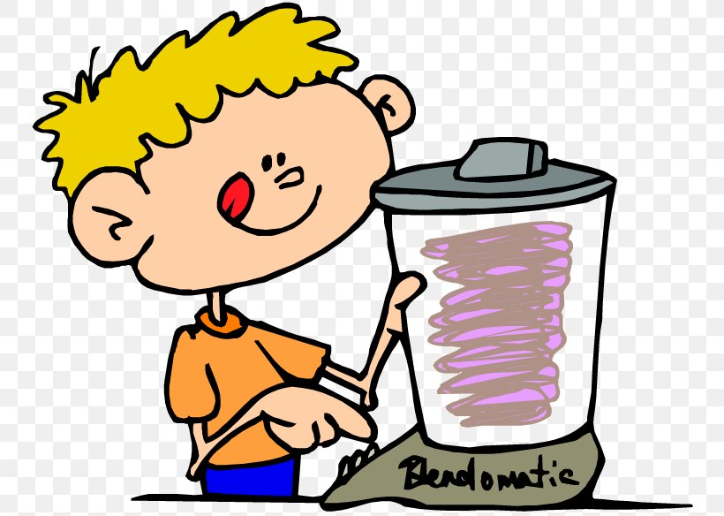

segmenting
blending

Slide 5

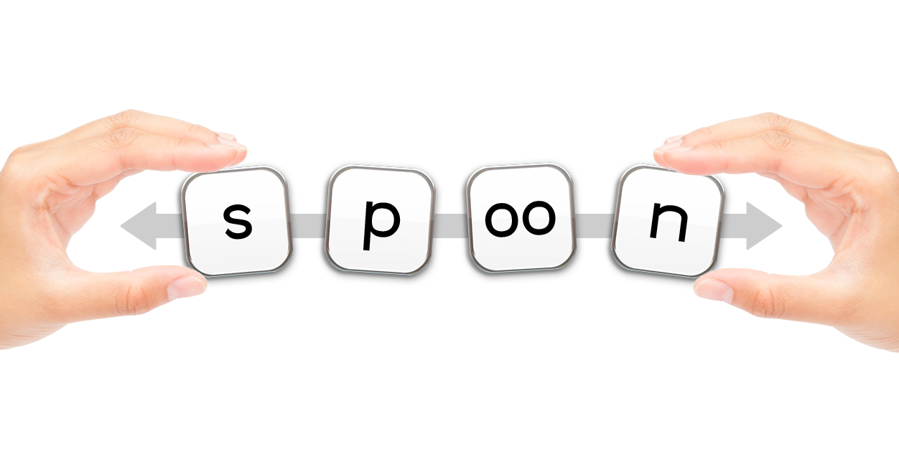
segmenting
railway
r
ai
l
w
ay

Slide 6
Segmenting is normally the bit children find the most difficult. Either…
Not remembering the different sounds
Not spotting the digraphs (two letters, one sound) or trigraphs (three letters one sound)

Slide 7
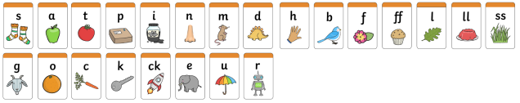
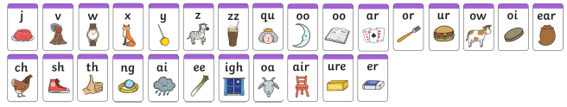
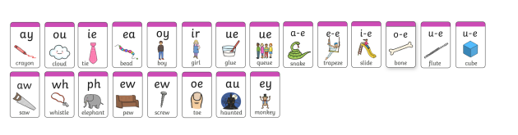

Slide 8
goat
night
cloud
chopstick
soundbuttons

Slide 9
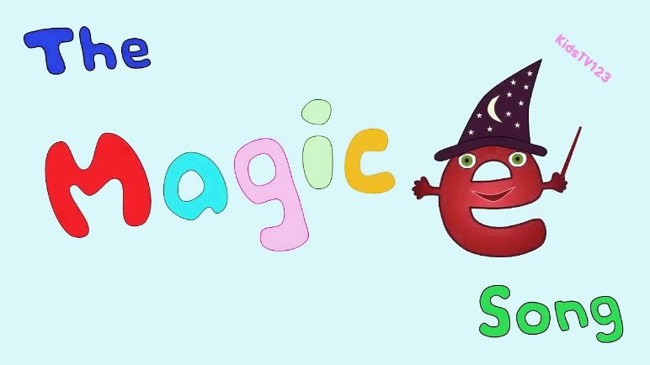
a-e
e-e
i-e
o-e
u-e
We call
them split spellings
cake
slide
phone

Slide 10

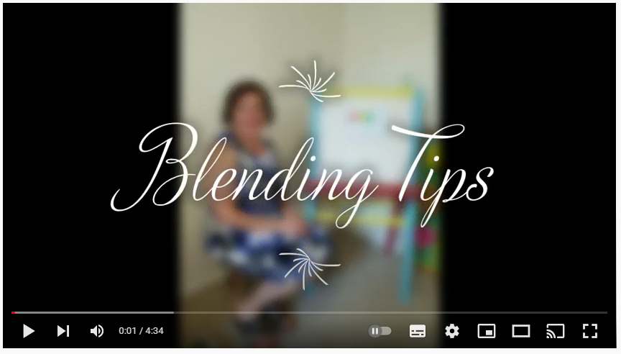
Blending
The process of putting sounds
together to make a word
https://www.youtube.com/watch?v=AD-e441wuks&t=153s
mat
mmmmmaaaaaaaaatttttttttt

Slide 11
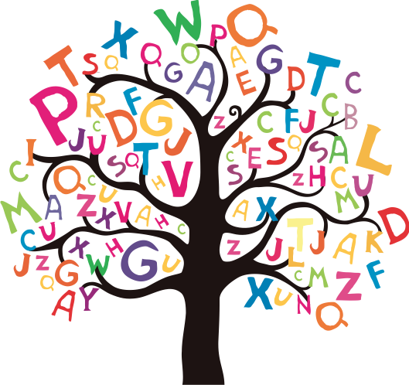
Phonics Lessons

Slide 12

www.phonicsplay.co.uk
£6 per year!

Slide 13
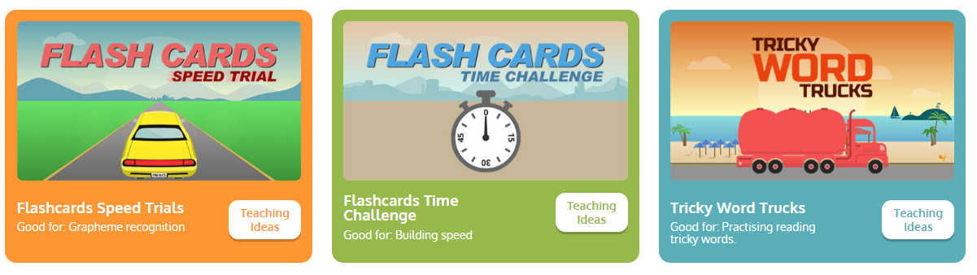

Slide 14
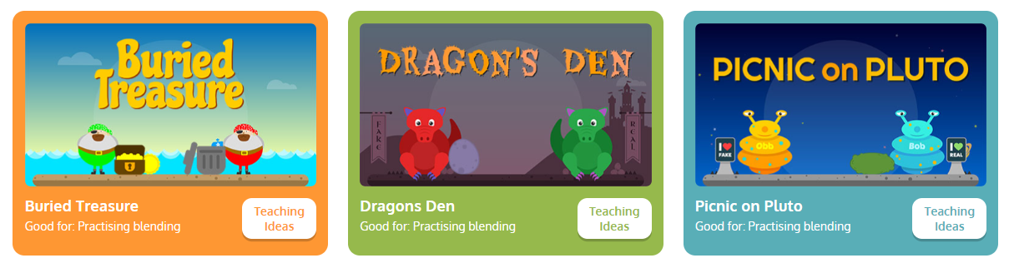

Slide 15

ar
k
d
____ ____ ____

Slide 16
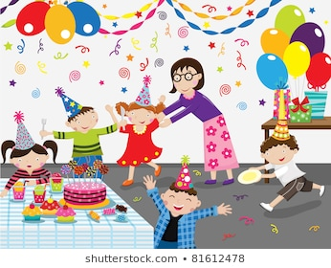
y
ar
t
p
____ ____ ____ ____

Slide 17

u
-
e
r
d
____ ____ ____ ____

Slide 18
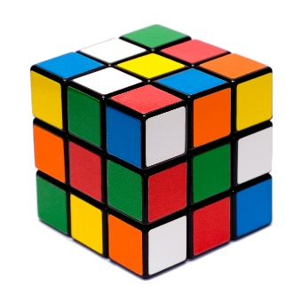
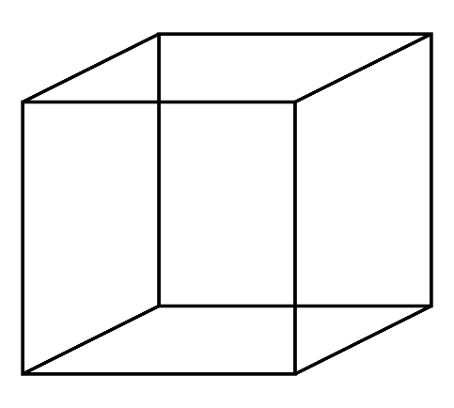
u
-
e
c
b
____ ____ ____ ____

Slide 19
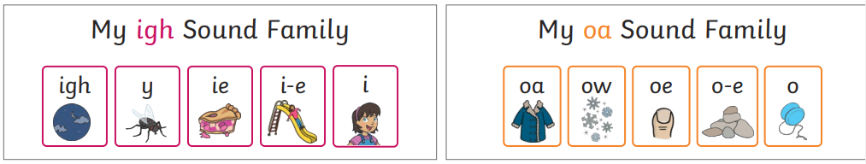
In phonics, we learn that there
are different ways to make the same
sound

Slide 20
And that sometimes the one grapheme
(the way of writing a sound) can make different sounds.
Eg.
cow
snow.
cry
sunny.
glue
statue.

Slide 21
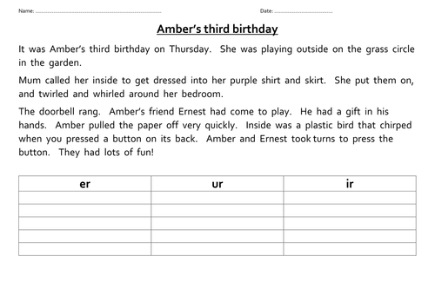
Phoneme (sound) spotters

Slide 22

Phonics Screening Test

Slide 23
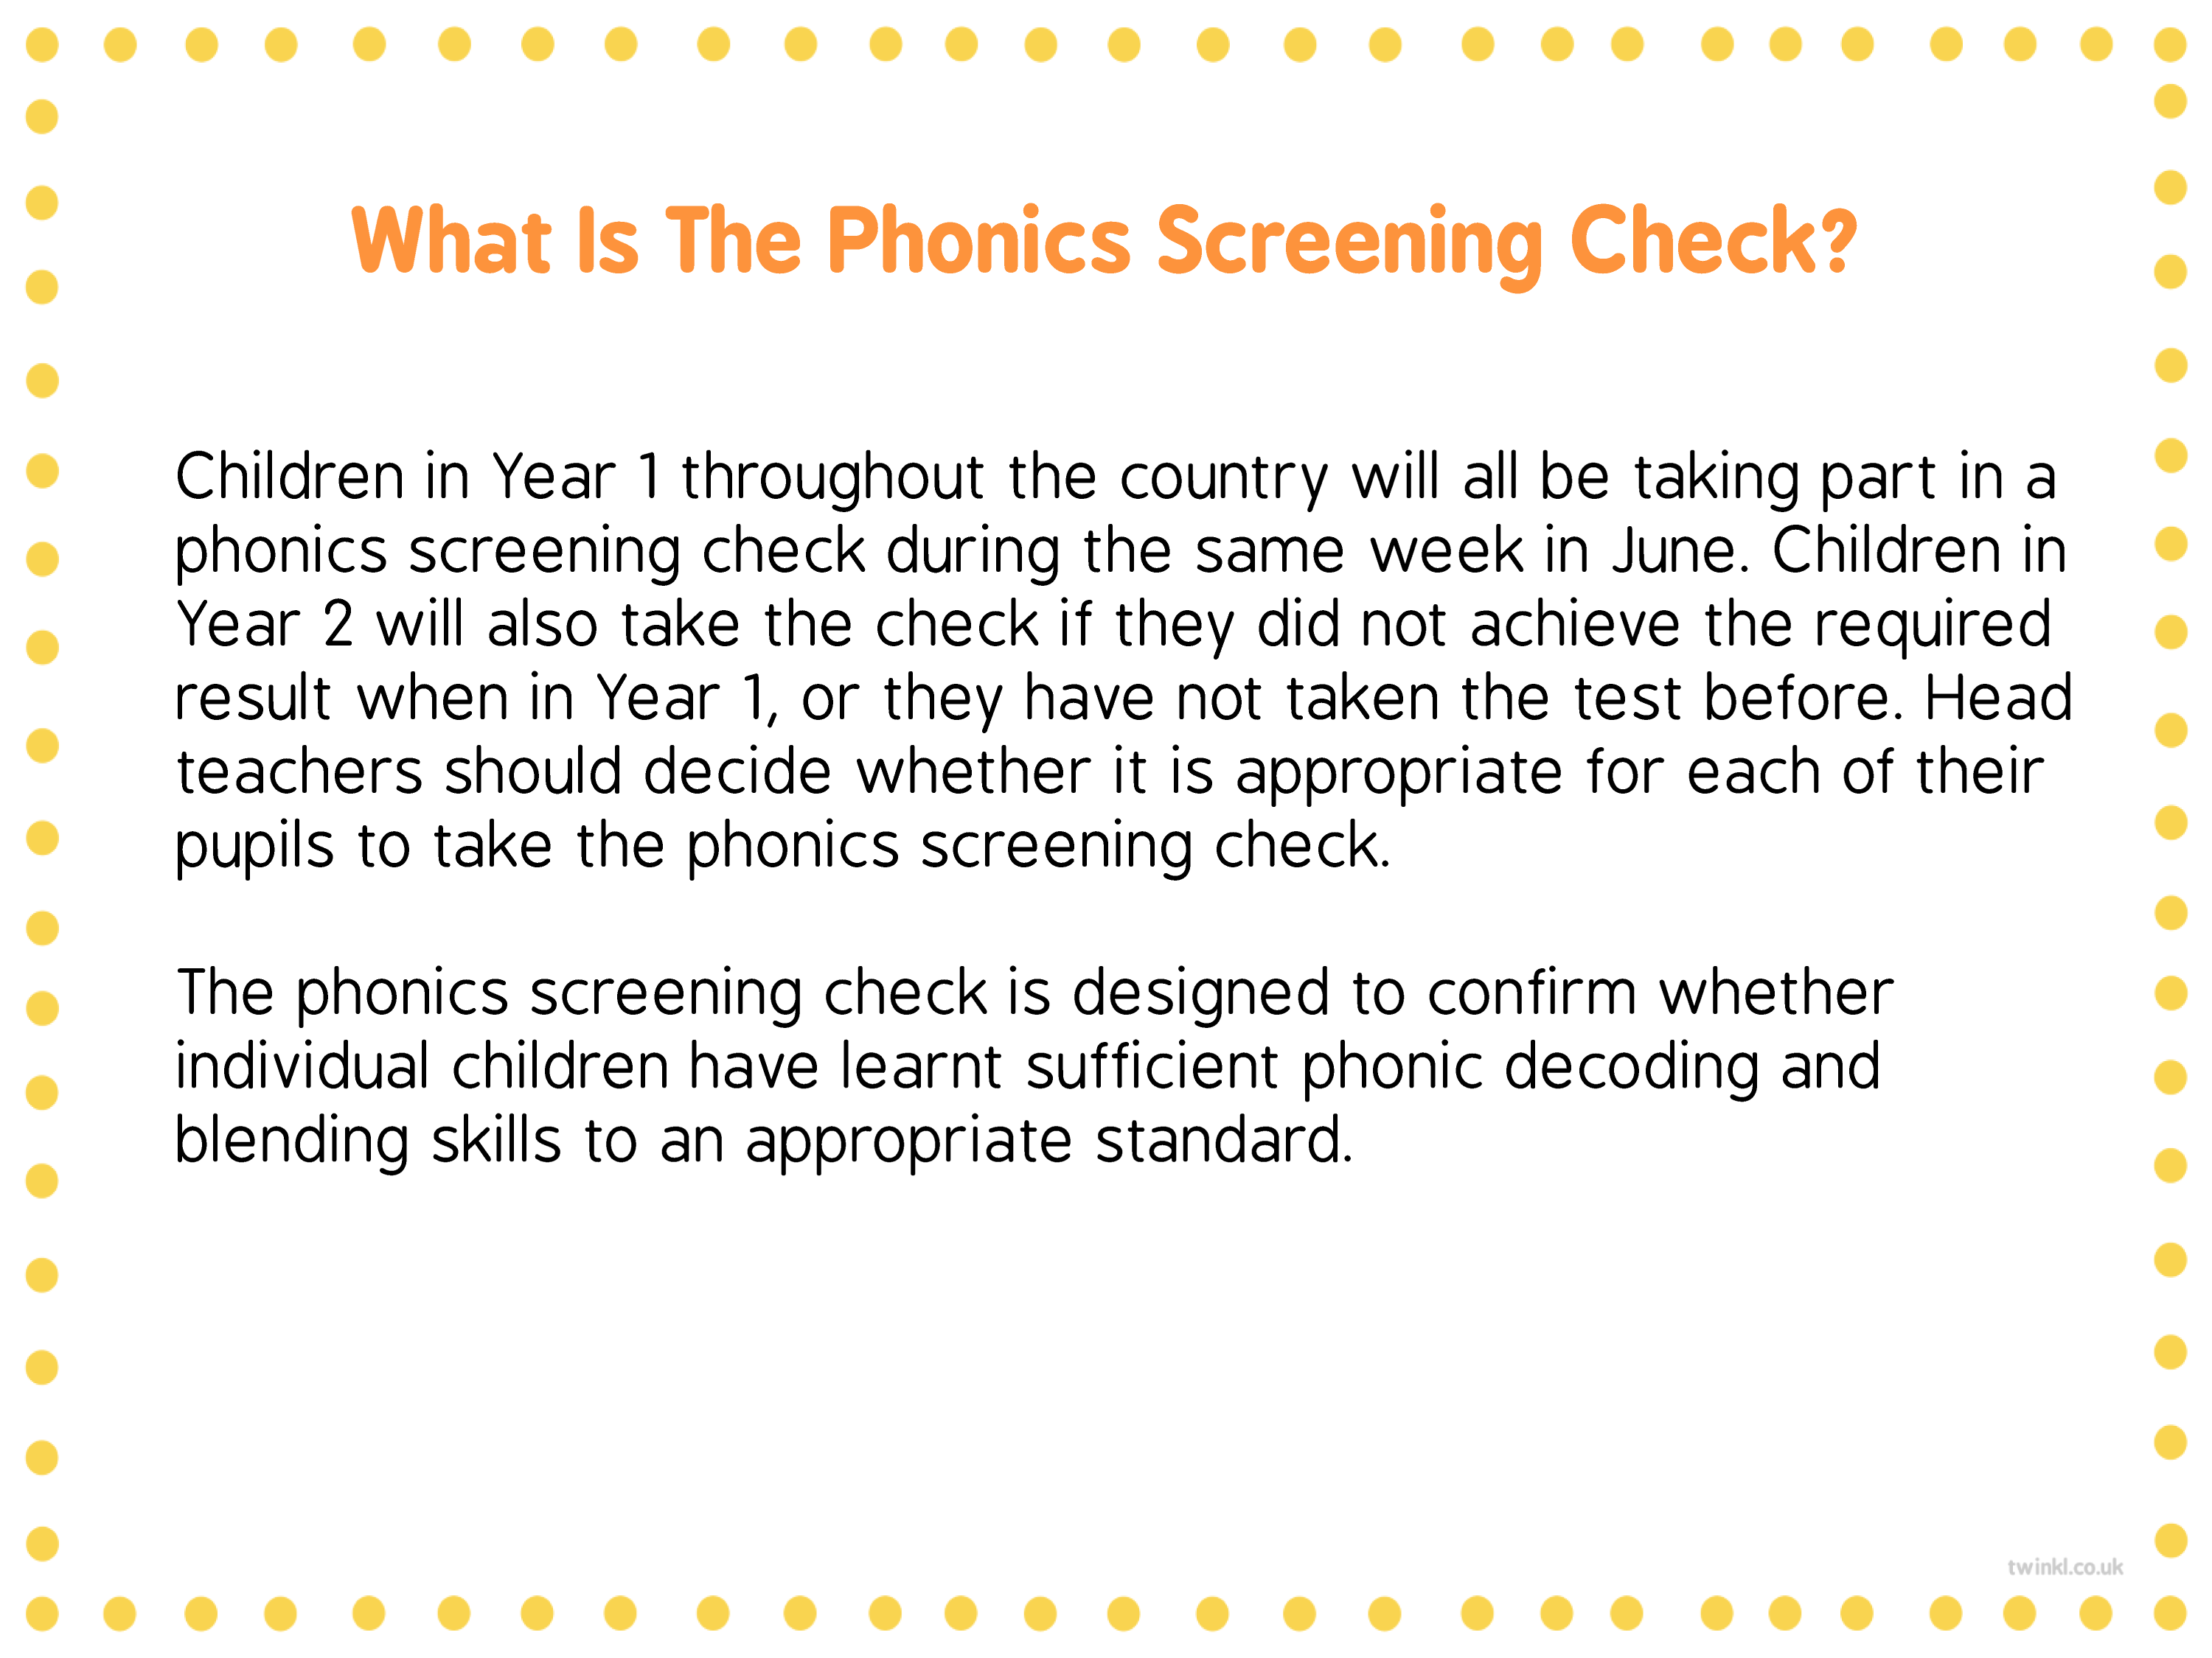

Slide 24
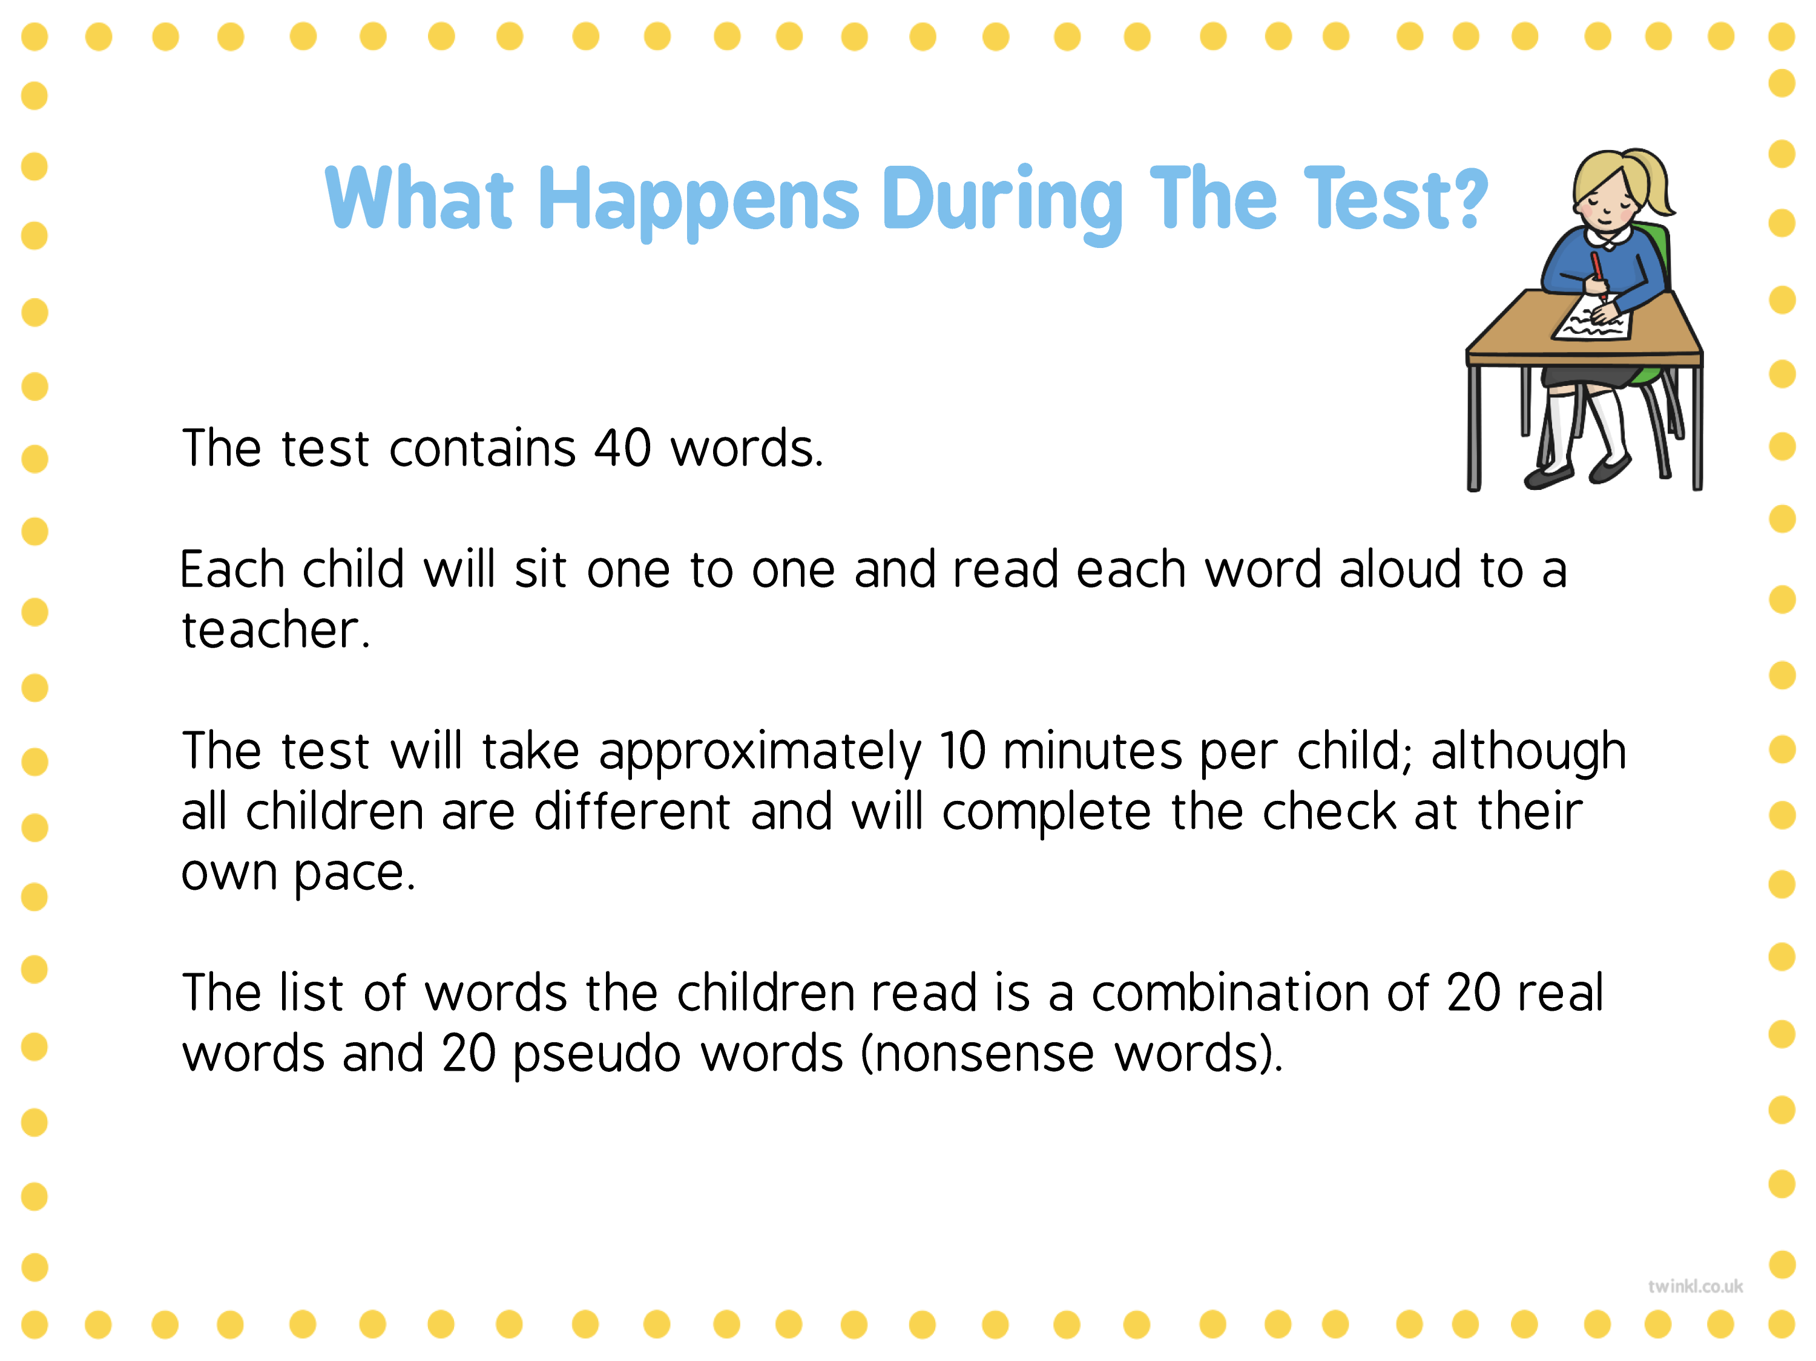
(32/40 usually a ‘pass’ – changes each
year)

Slide 25
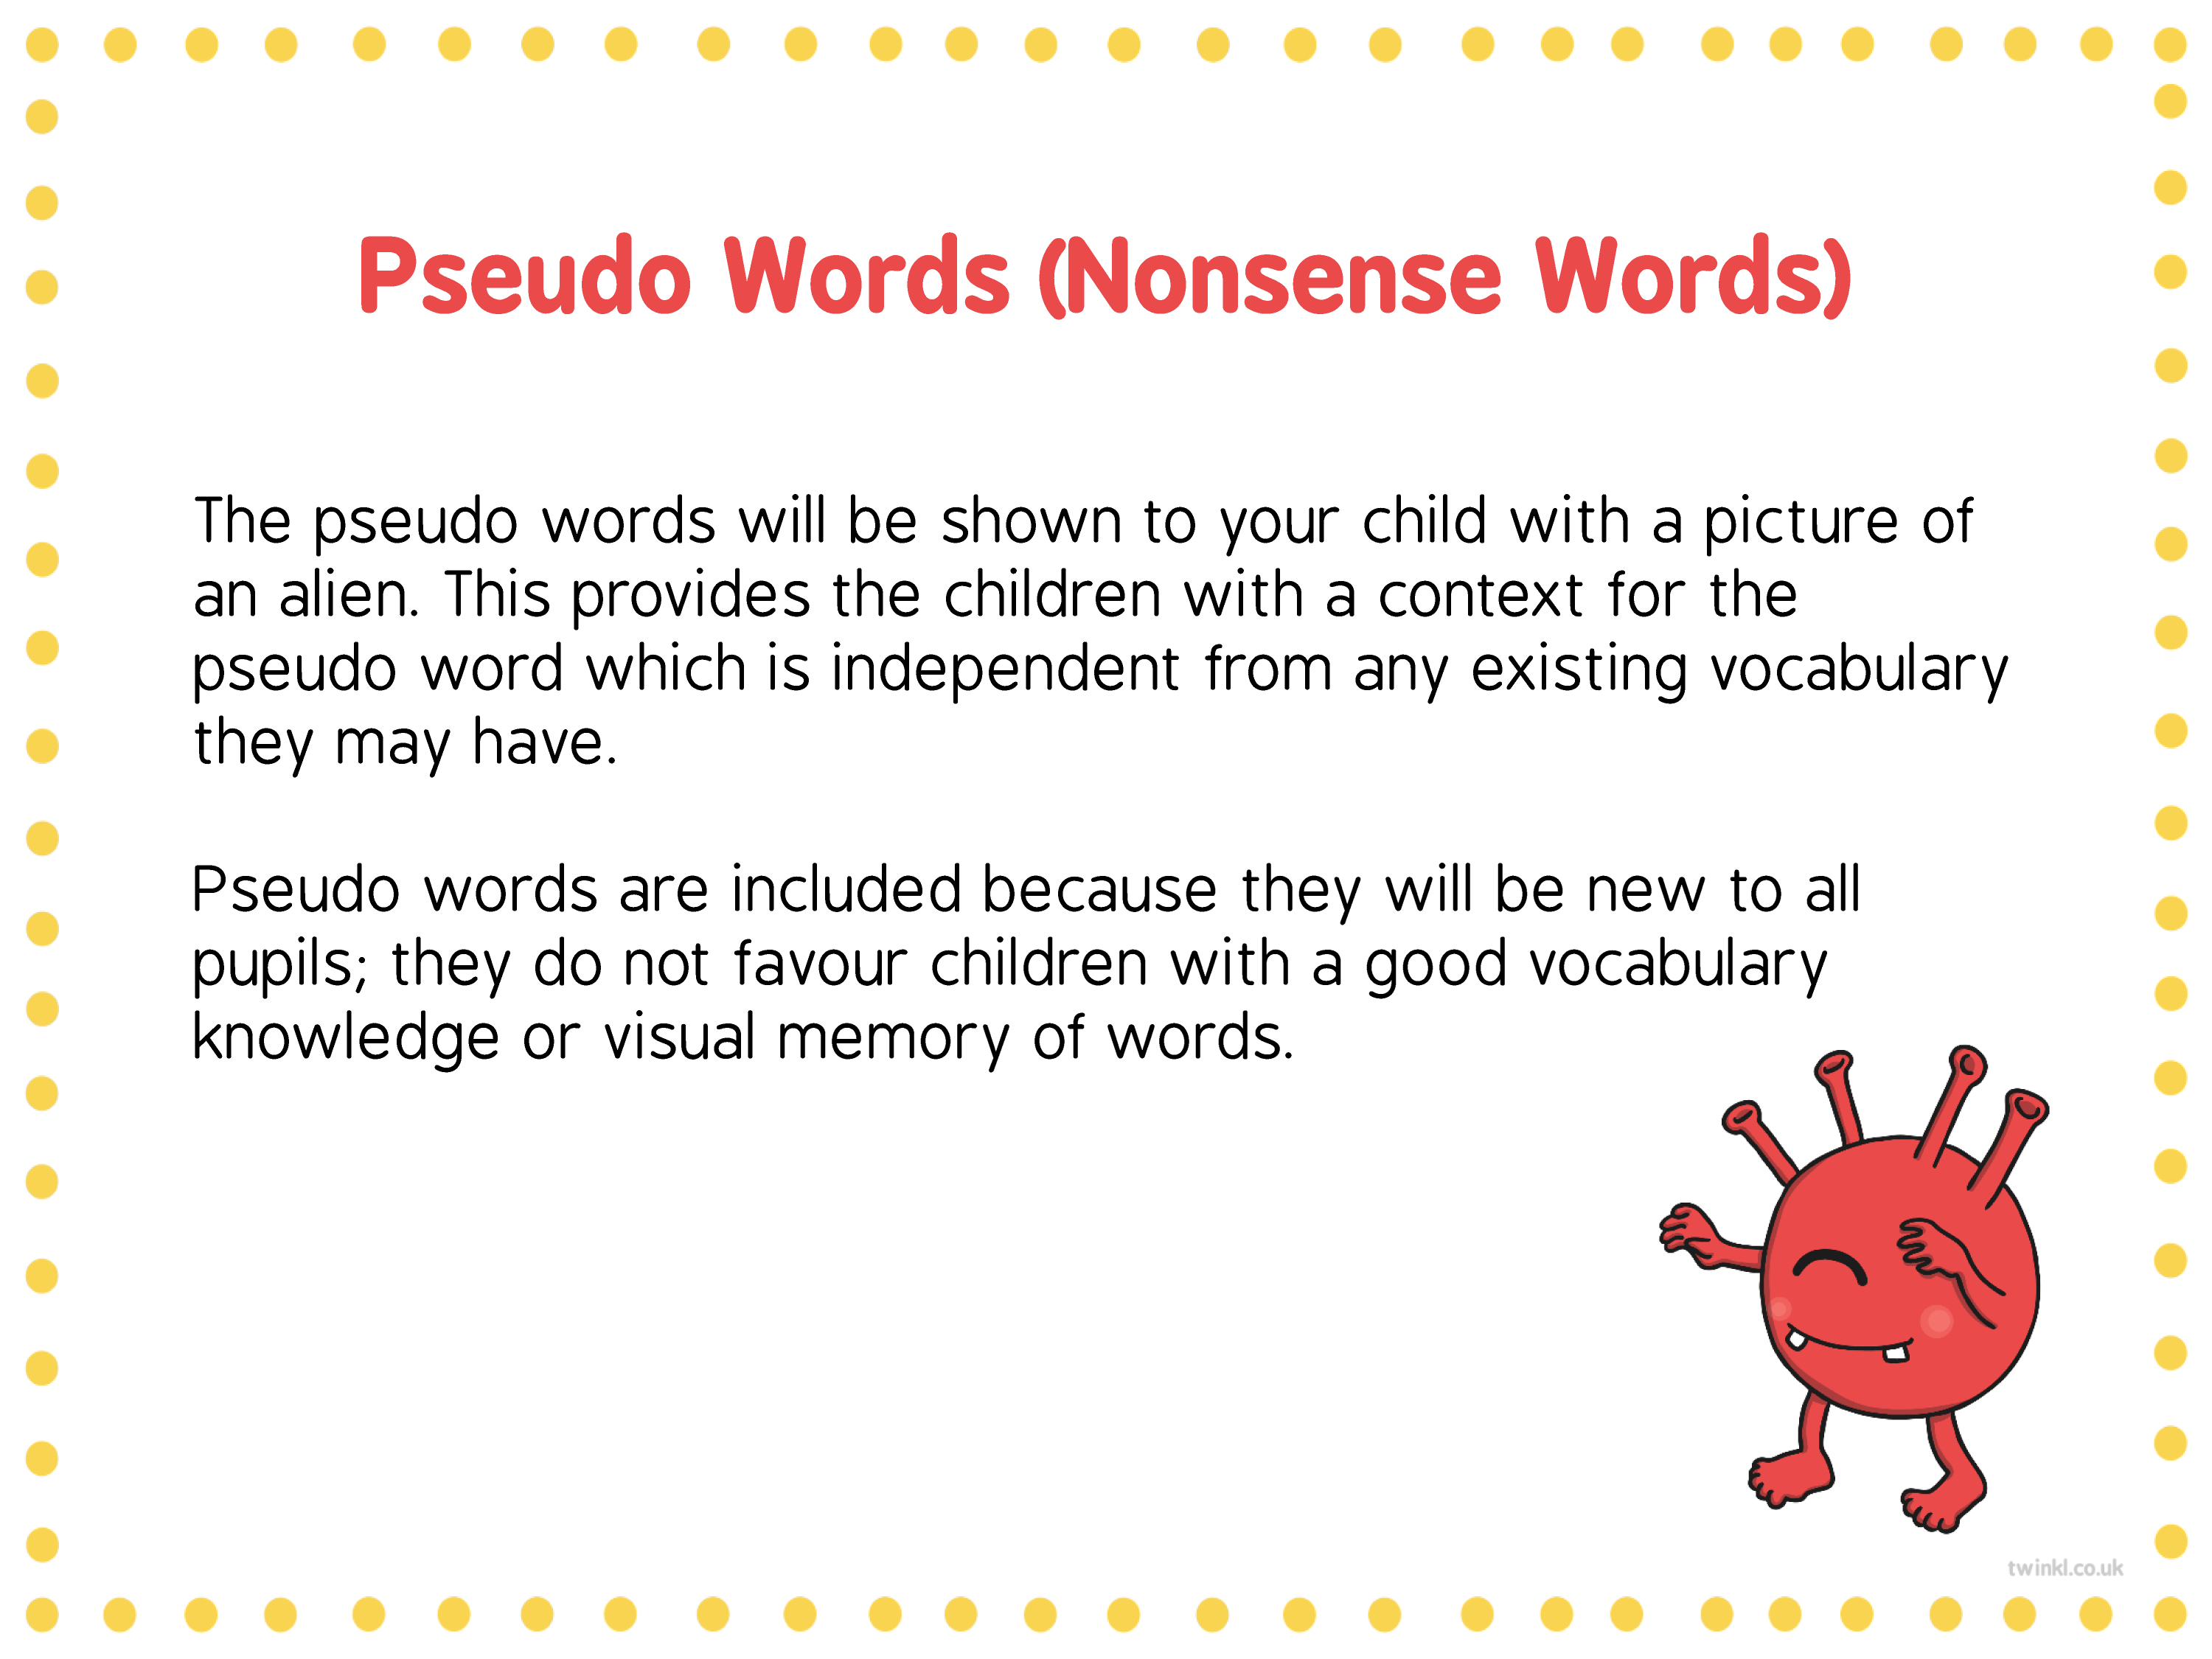

Slide 26


Slide 27


Slide 28
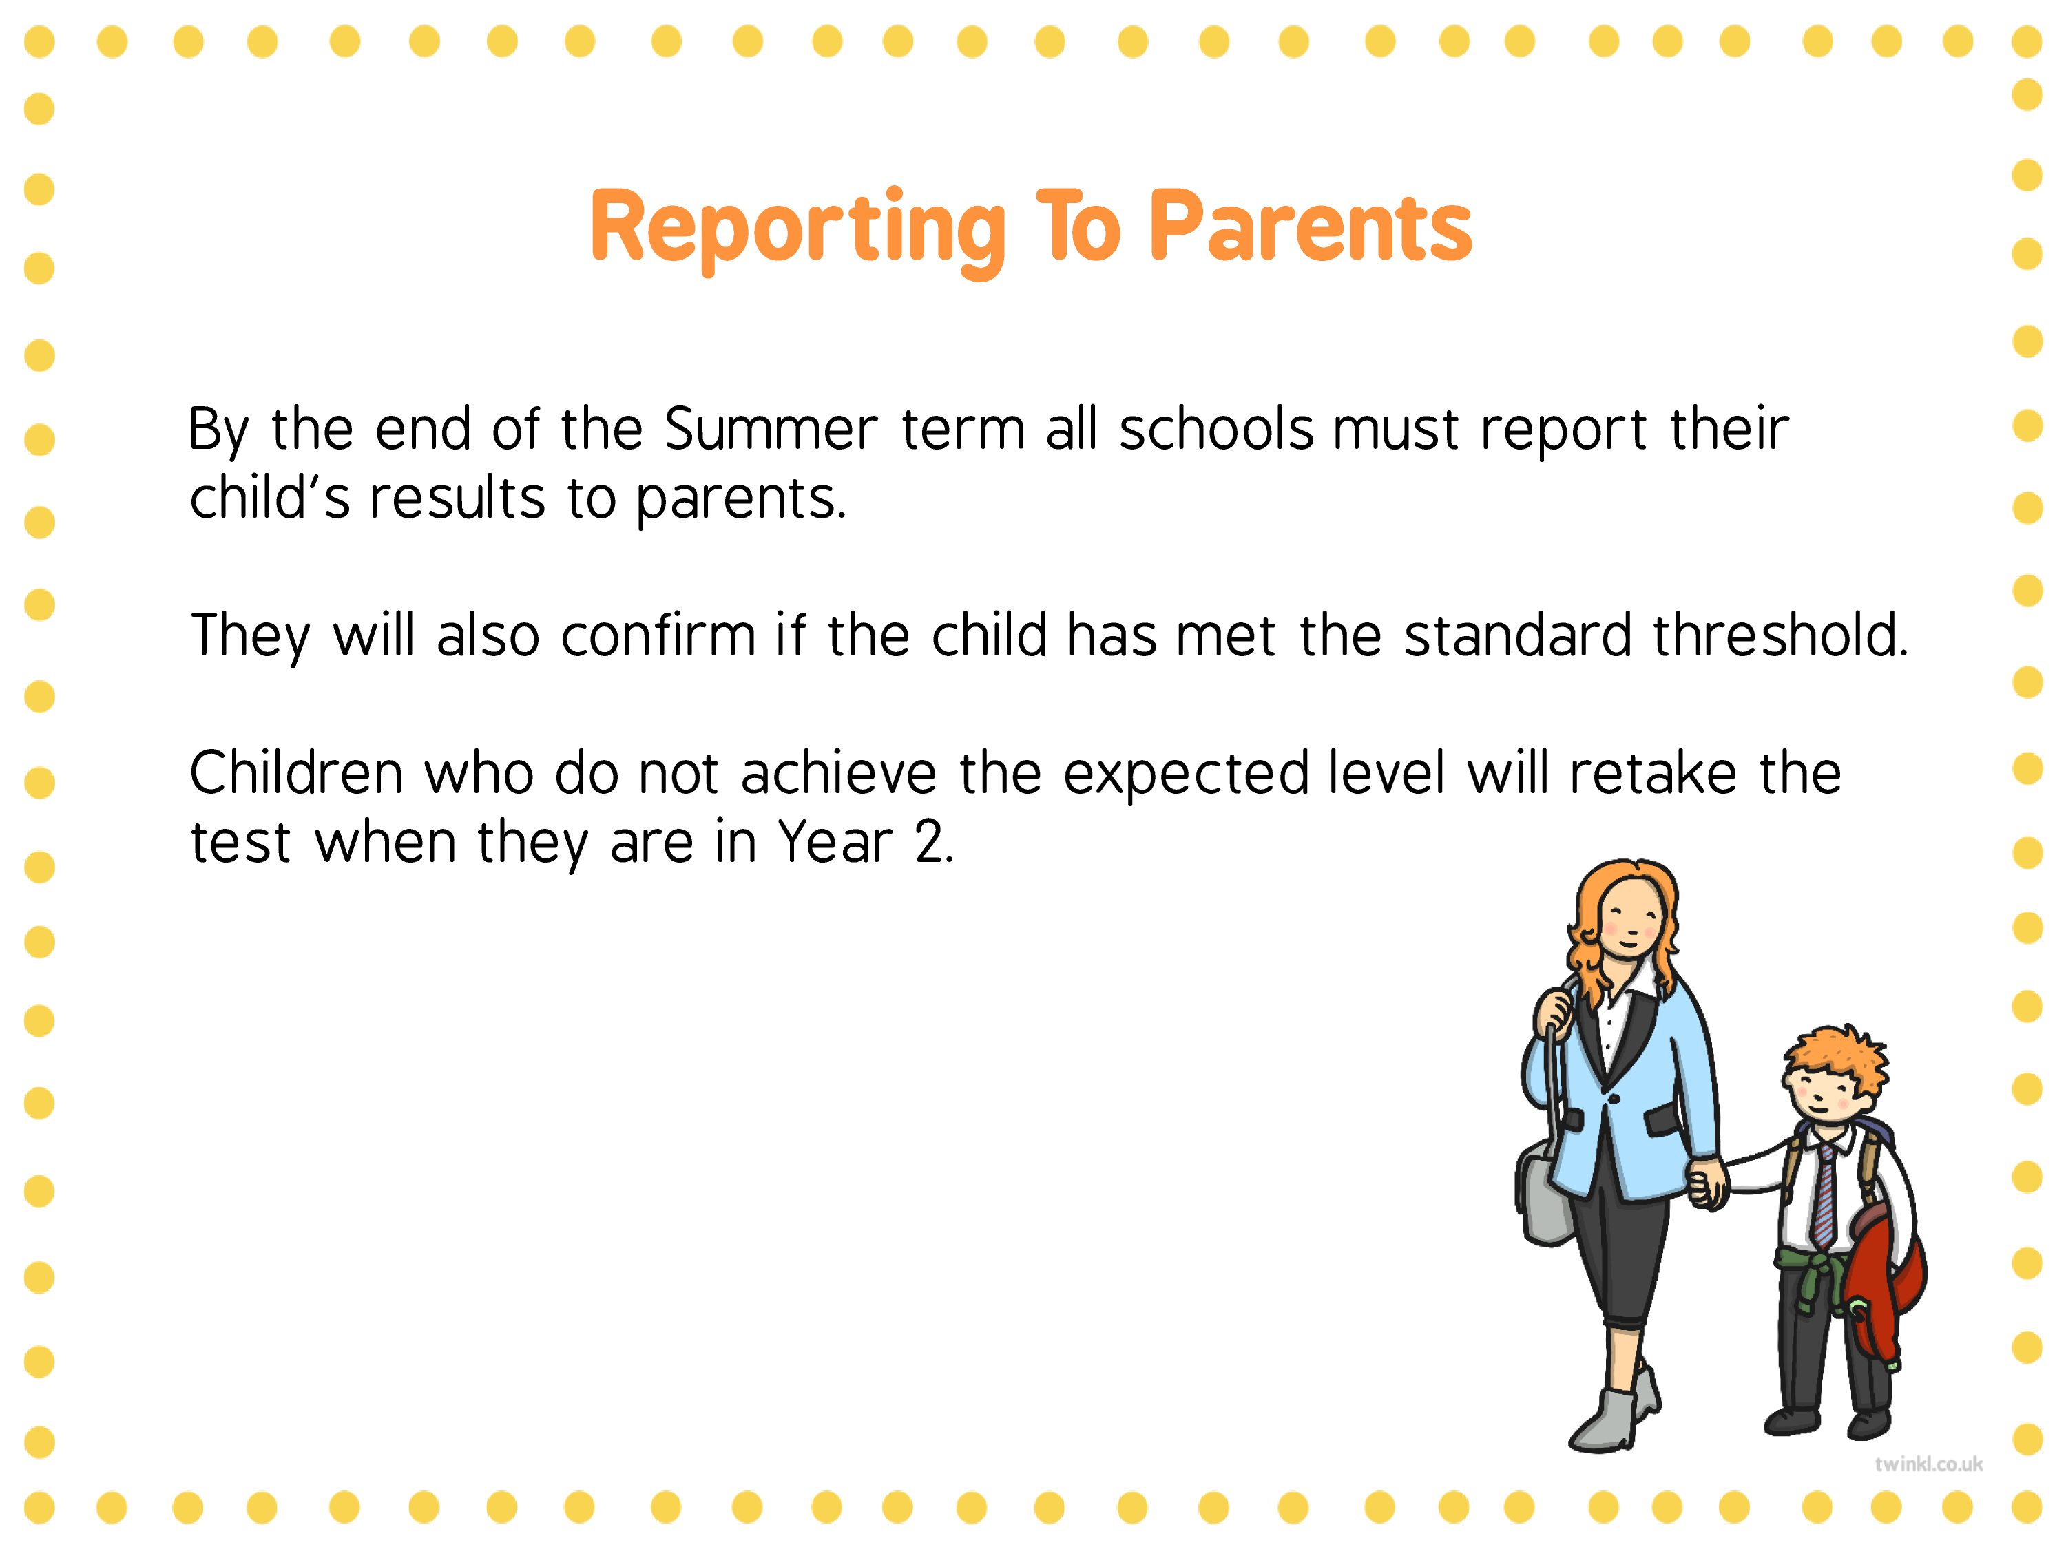

Slide 29
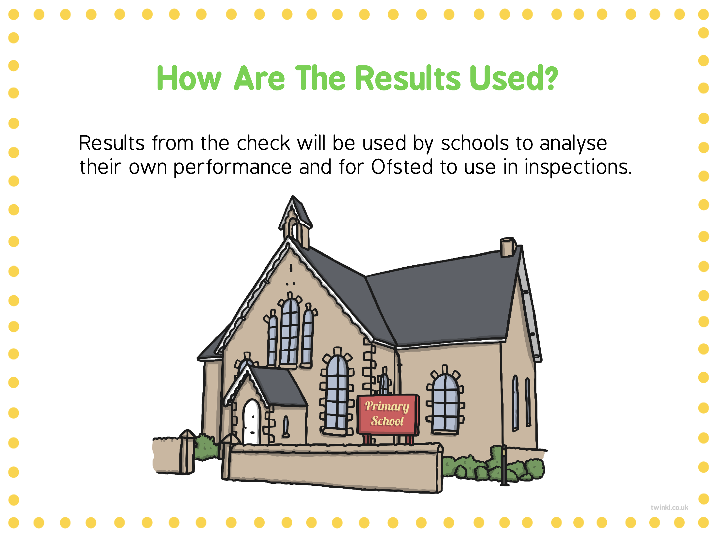

Slide 30
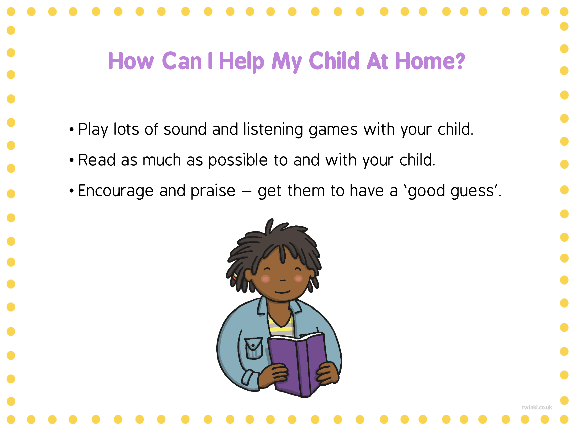

Slide 31
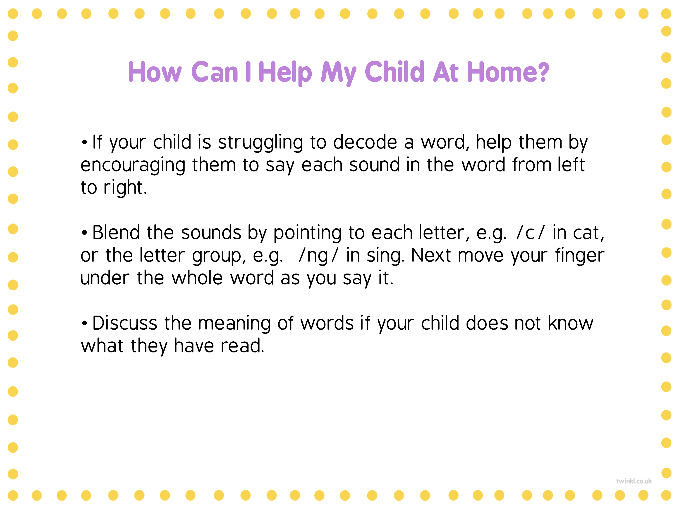

Slide 32
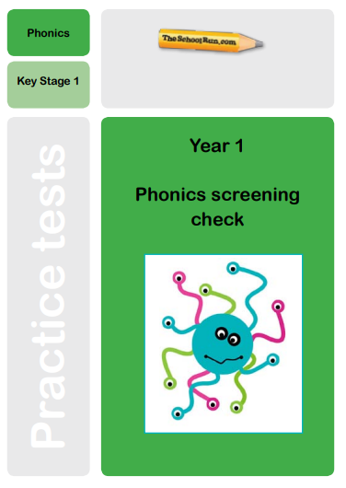
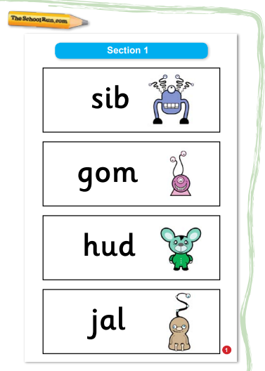
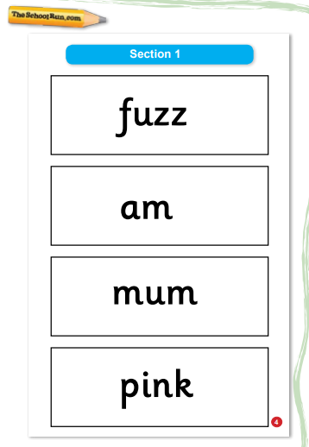
Practise Tests

Slide 33
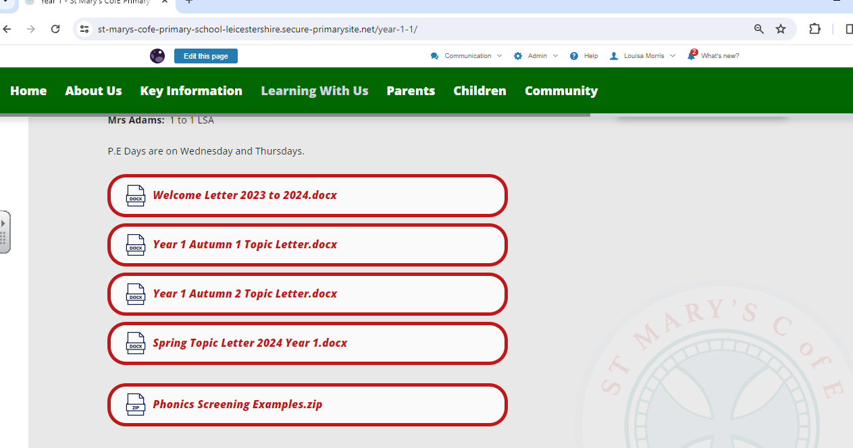

Slide 34
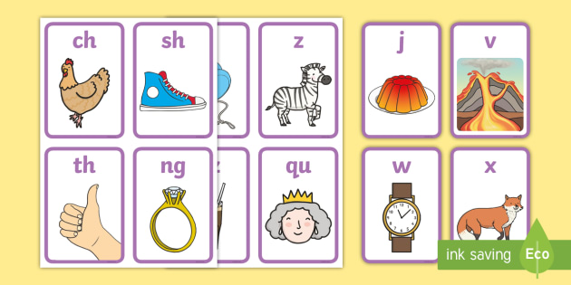
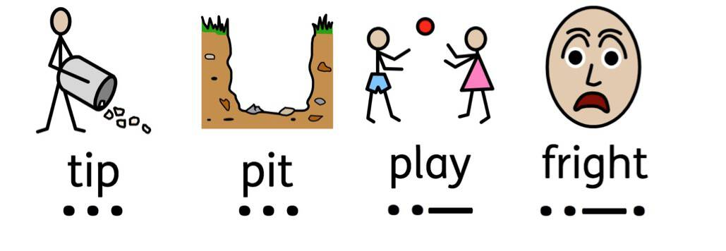

Things you can do at home (time permitting)
practise flashcards – keep
sounds apart they need to practise.
Little and often!
Practise spotting sounds / digraphs
in words
Read as often as possible!!!

